Slide 1

CRUDE OIL PRICE PREDICTION
PRESENTED BY:
Vallabh Ram Josyula
Olachi Gogo-Achonwa
Kavya Garigapati
Anjana Harinarayanan
Madhavi Goli

Slide 2
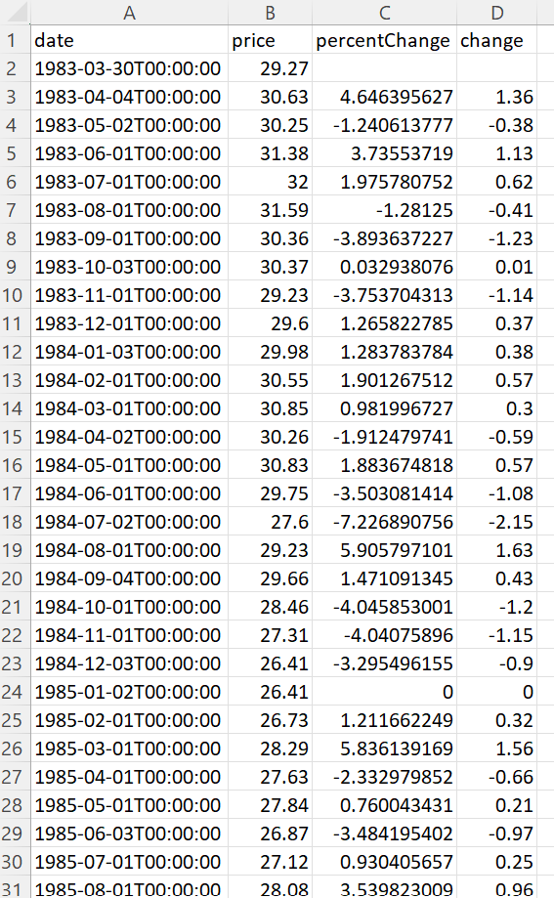
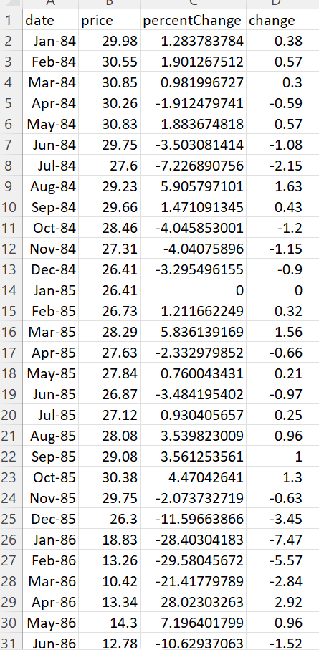
Data Collection & Cleaning:
Raw data
This dataset contains current crude oil prices (in USD) for the period of 1983 to 2022.
We employ the period 2013–2022.
Variables: Date – The date on which Price is Noted Close - Close Price of the Crude Oil in USD/BBL
- 1 BBL = 42 US gallons.
Link: https://www.kaggle.com/datasets/sc231997/crude-oil-price
Formatted data
This data has been formatted in accordance with the date specifications to perform time-series analysis and run predictive models with accuracy.

Slide 3

Forecasting models
We will create trends (seasonal & non-seasonal trends) and analyze crude oil prices over the last ten years using the models:
Time Series using Linear Regression Model
ARIMA Model
Exponential Smoothing Model
This Photo by Unknown Author is licensed under CC BY-ND

Slide 4

Research questions and rational
To determine the validation period forecast.
To calculate the accuracy and the RMSE of the Validation Period.
To establish which model performs forecasting tasks more effectively.

Slide 5
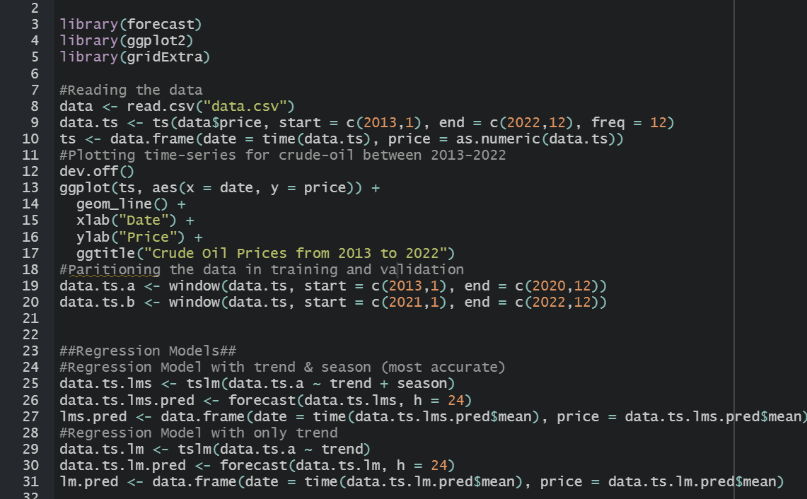
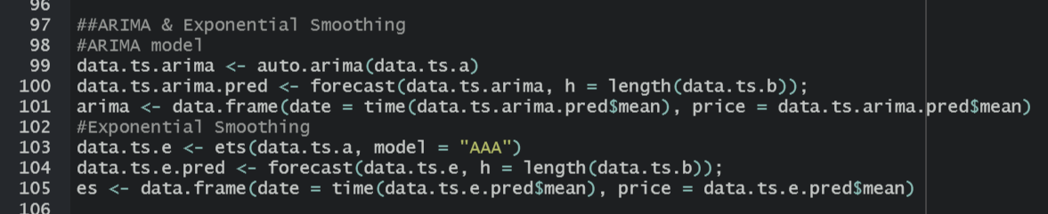
R Studio Code:
Data Partitioning & Regression Models:
ARIMA & Exponential Smoothing Models:

Slide 6
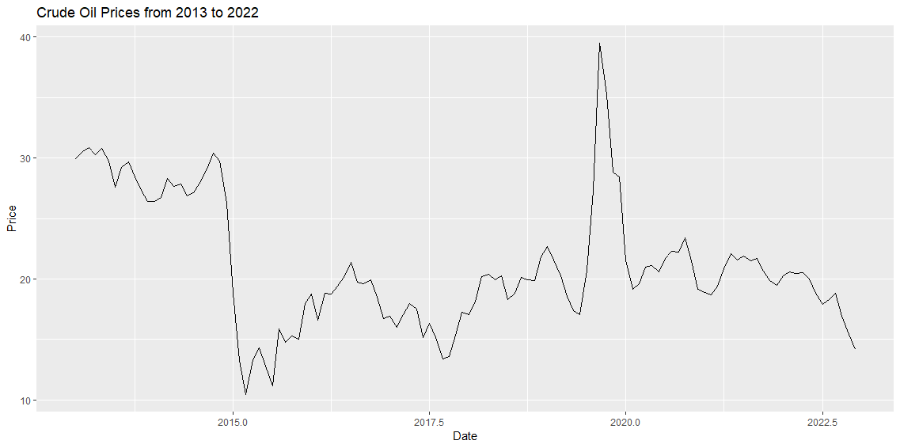
Data Analysis
Converted the data into time series and analyzed the crude-oil price trend in the last 10 years.

Slide 7
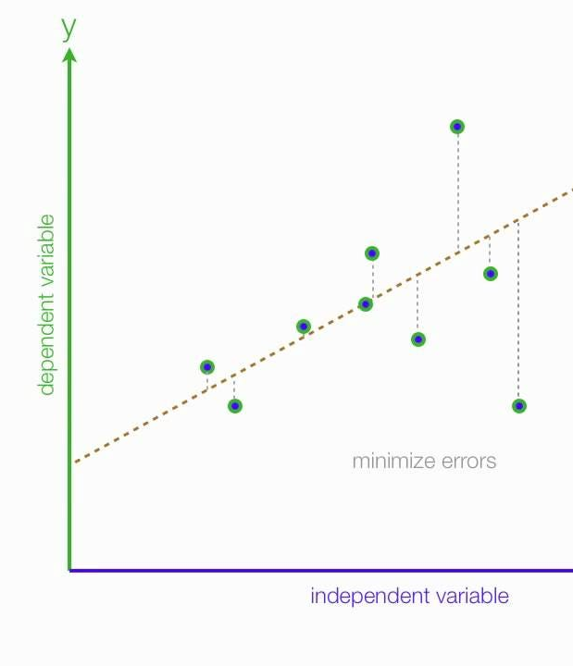
Linear Regression
Linear regression is a statistical tool used to
help predict future values from past values.
It is commonly used as a quantitative way to
determine the underlying trend and when prices are
overextended.
Independent and dependent variables,
but the dependent variable is always the same:
sales performance. Whether it’s total revenue or
number of deals closed , your dependent variable
will always be sales performance.
Regression equation : Y = bX + a

Slide 8
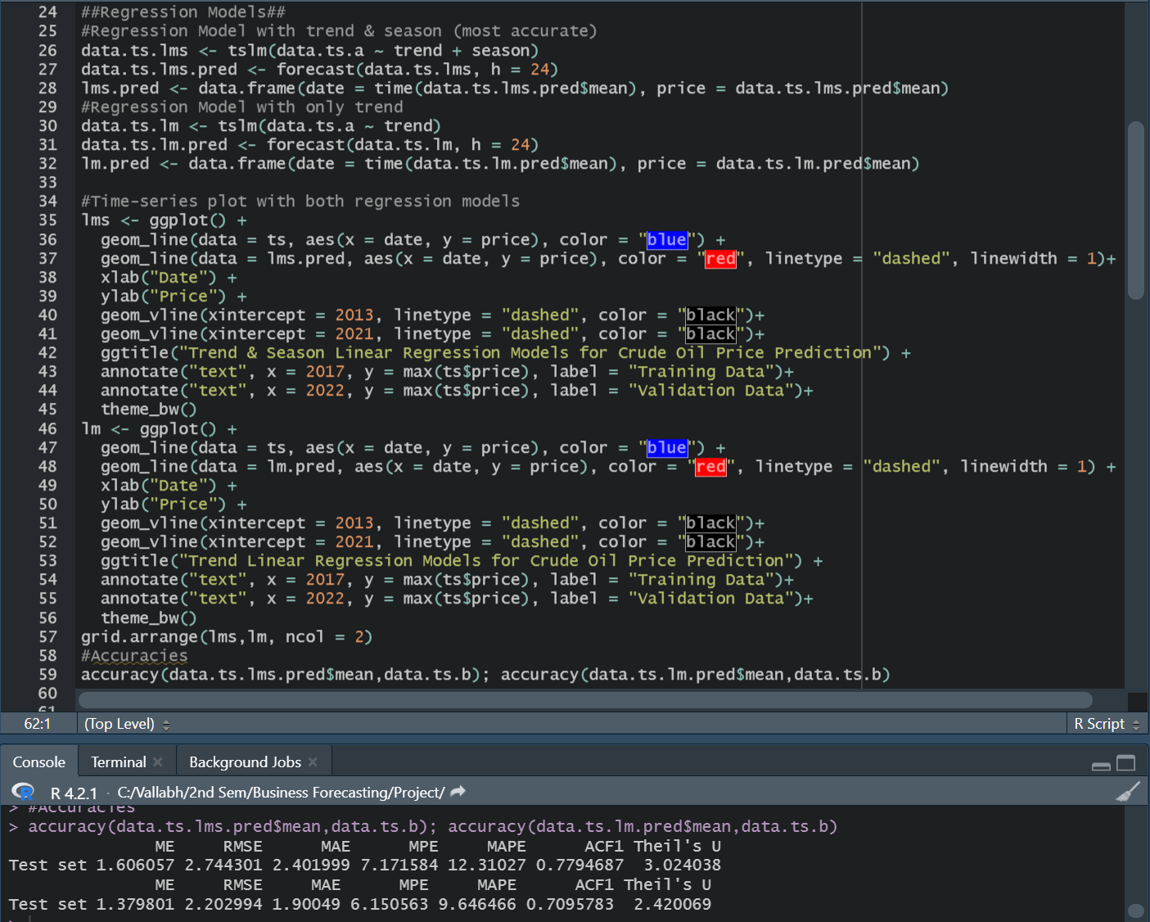
Linear Regression Models With Accuracies:

Slide 9
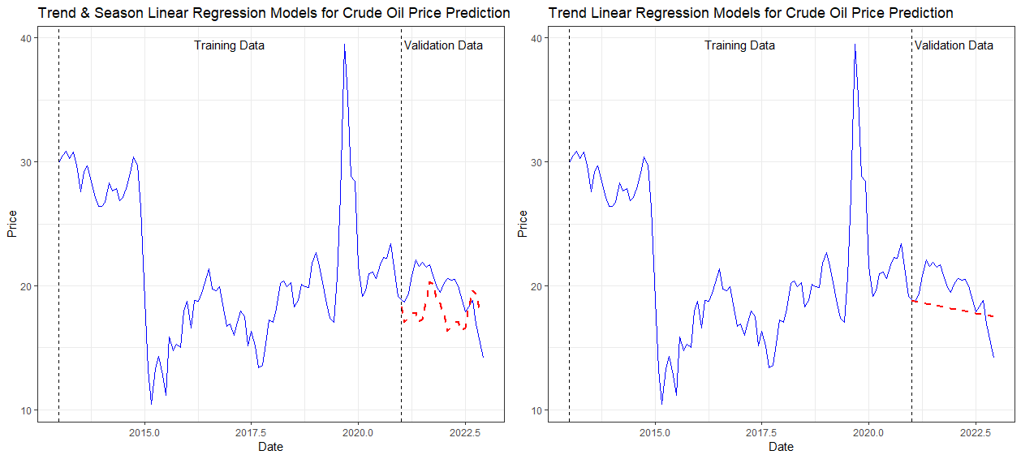
Linear Regression Outcomes:

Slide 10
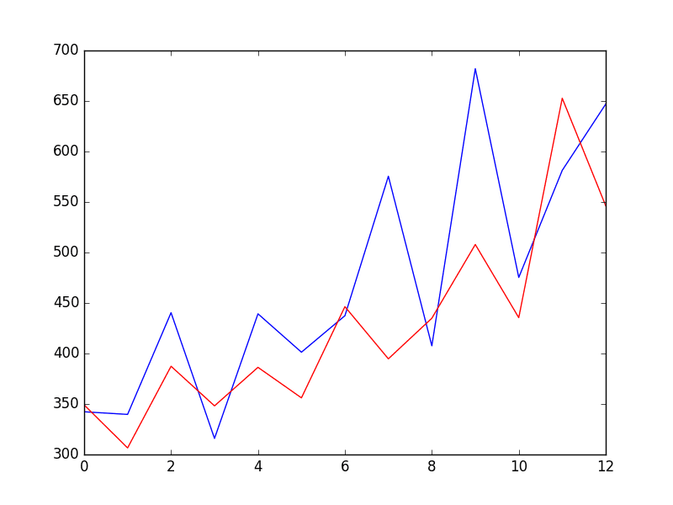
ARIMA Model: “Autoregressive Integrated Moving Average”
An ARIMA model is a class of statistical models for analyzing and forecasting time series data. It explicitly caters to a suite of standard structures in time series data, and as such provides a simple yet powerful method for making skillful time series forecasts.
Basic formula: y’(t) = c + ϕ1* y′(t−1) +⋯ + ϕp*y′(t−p) + θ1*ε(t−1) +⋯ + θq*ε(t−q) + εt

Slide 11
Exponential Smoothing Model:
Exponential smoothing model is a forecasting technique for univariate time series data. With this method, forecasts are weighted averages of historical observations, with the weights of older observations decreasing exponentially.
Basic formula: S_{t} = αy_{t-1} + (1 – α) S_{t-1}
α = the smoothing constant, a value from 0 to 1.
t = time period.

Slide 12
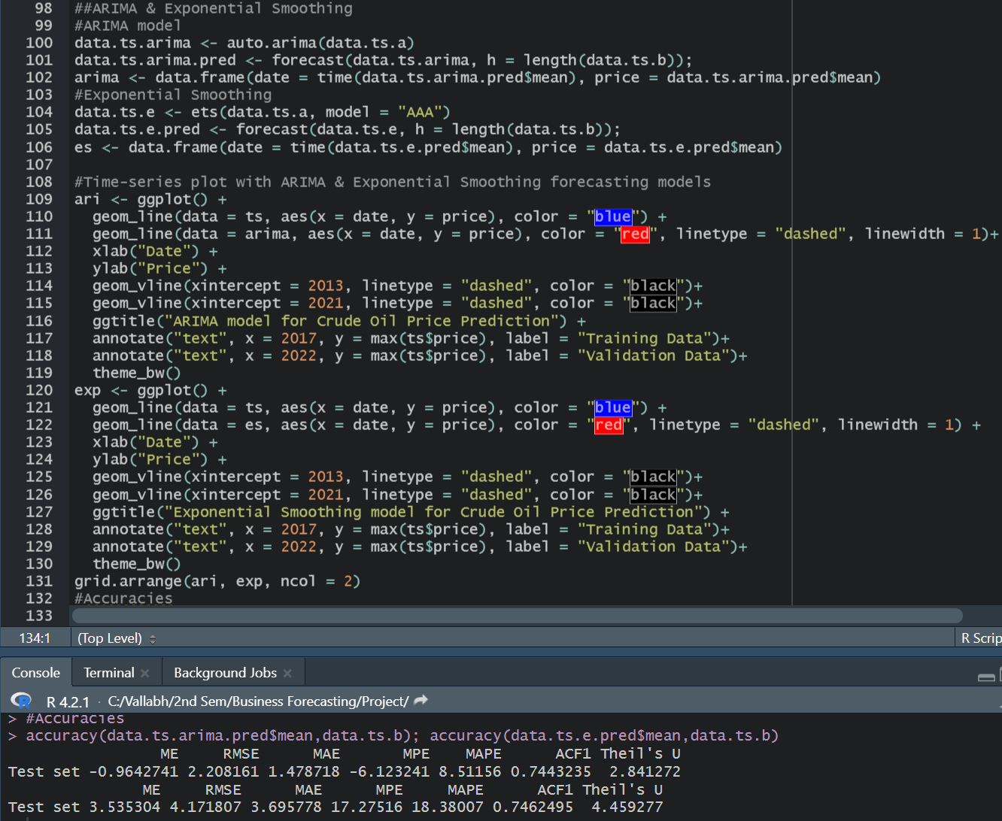
ARIMA & Exponential Smoothing Model : Code and Accuracy

Slide 13
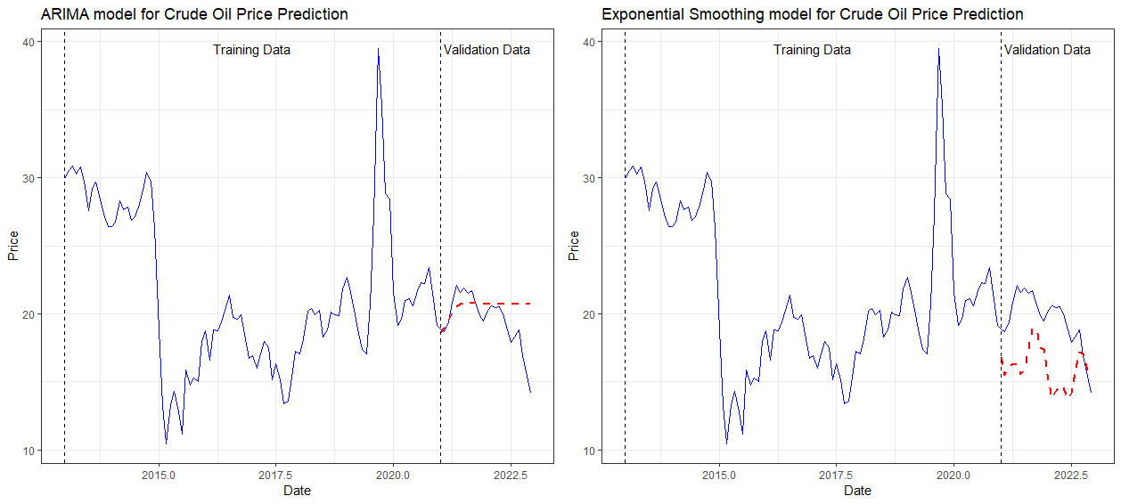
ARIMA Model and Exponential Smoothing Outcomes

Slide 14
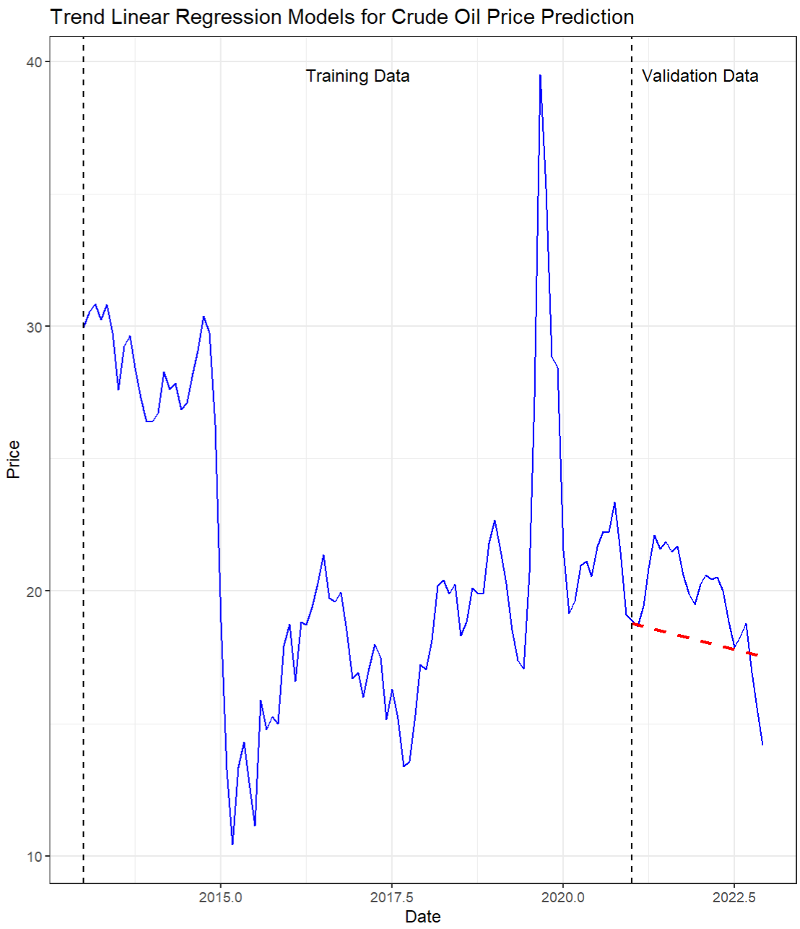
Outcomes:
Using regression, ARIMA, and exponential smoothing models, trends were created and the price of crude oil over the previous 10 years was examined.
Validated and determined the accuracy of all three models on the dataset, and discovered that the Linear Regression model with only Trend is the best fit for the data because the RMSE, Mean error, and absolute errors are lower when compared to others.
Because linear regression is the best fit for the data, it was used to predict the price of crude oil for the next two years.

Slide 15


